Slide 1

Decode 9.1
By:
Sachin S Ghanteppagol

Slide 2
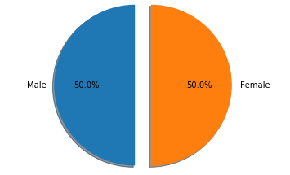
PS-1 Sales percentage by each Gender
Here,we could see there equal distribution of customers from both males and Females.

Slide 3
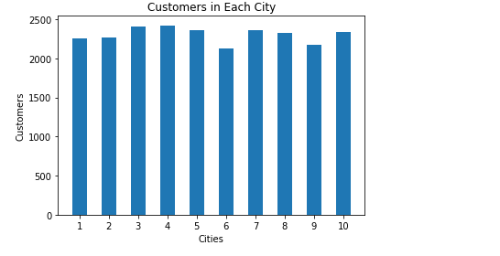
PS-2 Customers in Each City
City with code 4 has more number of customers and city with code 6 has less customers.

Slide 4
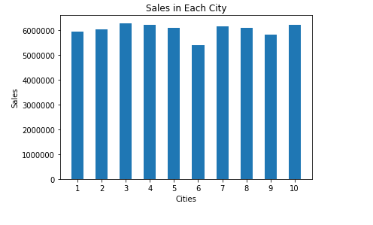
PS-3 City-wise Sales
Here,as there are more number of customers in city 4 has most sales and City 6 has less sales.

Slide 5
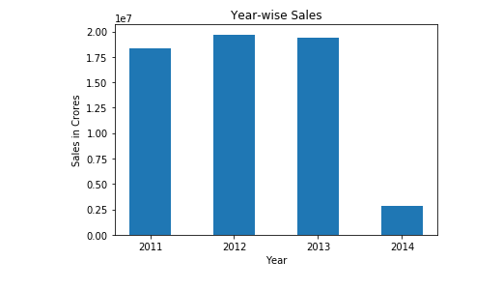
PS-4 Year wise sales
Sales has gone down in 2014.

Slide 6
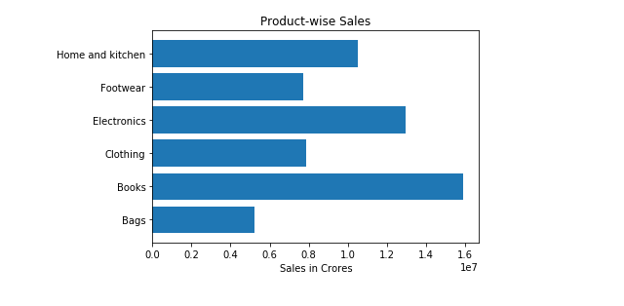
PS-5 Product Category wise Sales
Customers spent more money on Books.

Slide 7
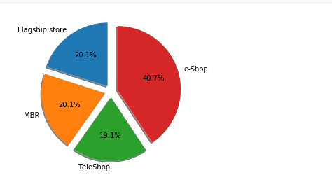
PS-6 Store-wise Sales
Customers preferred e-Shop than other stores.

Slide 8
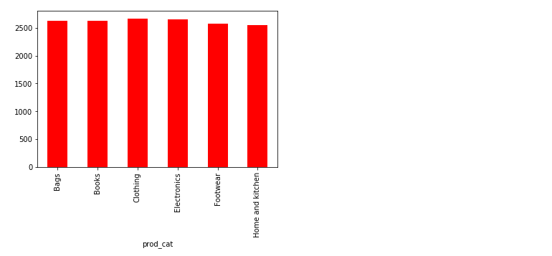
PS-7 Average amount spent on product Category
There is same average amount of money spent on each product category.

Slide 9
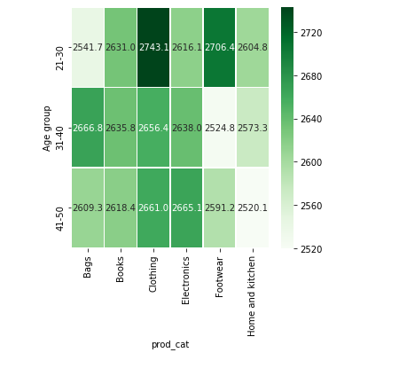
PS-8 Age vs. Product Category vs. Total Amount – 3 variables at a time
Customers with age group of 21-30 spend more and also on clothing as well.

Slide 10
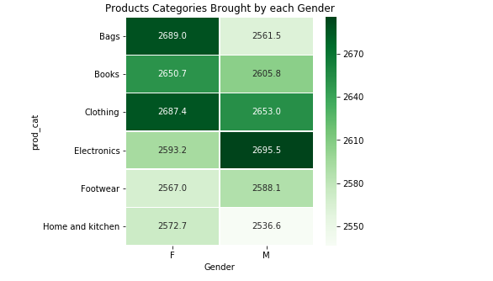
PS-9 Different Product brought by respective Gender
Here we could see females spent more on clothing and males on electronics.

Slide 11
Thank You

